Slide 1
Team U5 - WarZone (Risk Computer Game)
SOEN-6441: Advanced Programming Practices
Build 2
Team Members:
Abhishek Handa
Rajat Sharma
Harman Singh Jolly
Amanpreet Singh
Anurag Teckchandani
(40231719)
(40196467)
(40204947)
(40221947)
(40263724)

Slide 2
Naming Conventions
Data members, Member functions and Method Parameters
All are in lower camelCase like int thisIsExampleFunction (int p1, int p2)
And data members like int d_gameEngine
Classes
Class names are in upper CamelCase like
GameEngine.java and OrderExecutionPhase.java
Local Variables
They follow lower camelCase along with "I_." stating it is a local variable like
L_reader, l_continue
Static Members/Constants
All static members are in UPPER_SNAKE_CASE letters with underscores in between the words like int EXAMPLE_VALUE = alpha;

Slide 3
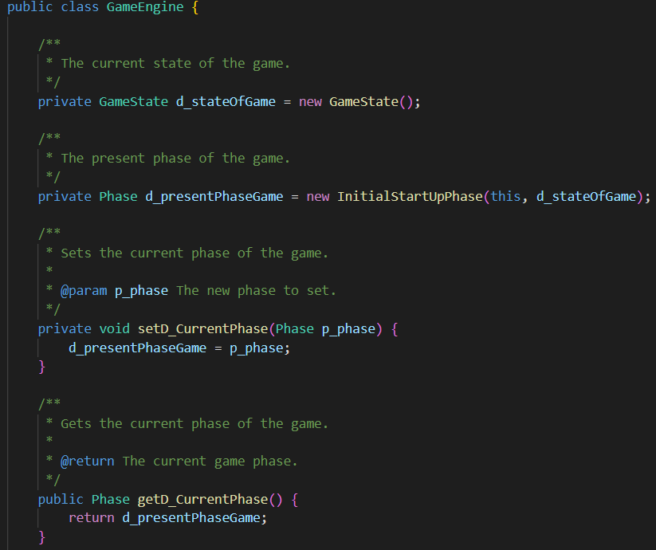
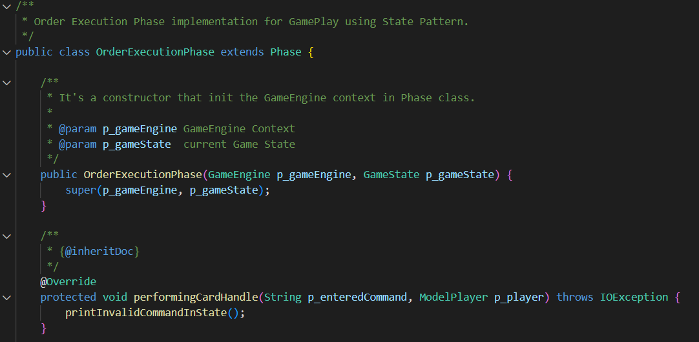
Example of Naming Conventions Used (Snapshots)

Slide 4
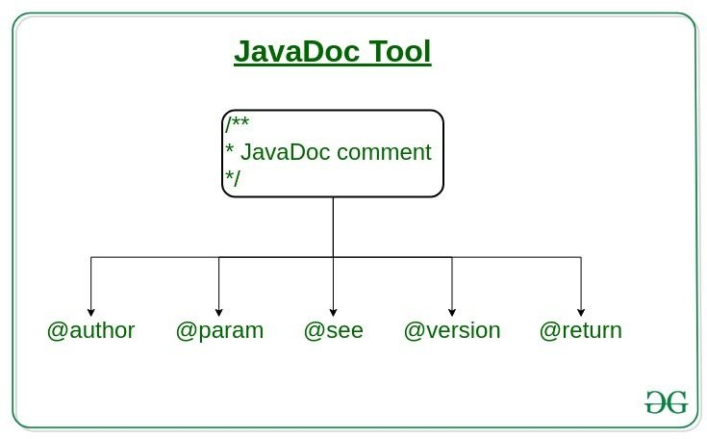
Javadocs
JavaDoc tool is a document generator tool in Java programming language for generating standard documentation in HTML format. It generates API documentation. It parses the declarations ad documentation in a set of source file describing classes, methods, constructors, and fields.
From GeeksForGeeks

Slide 5
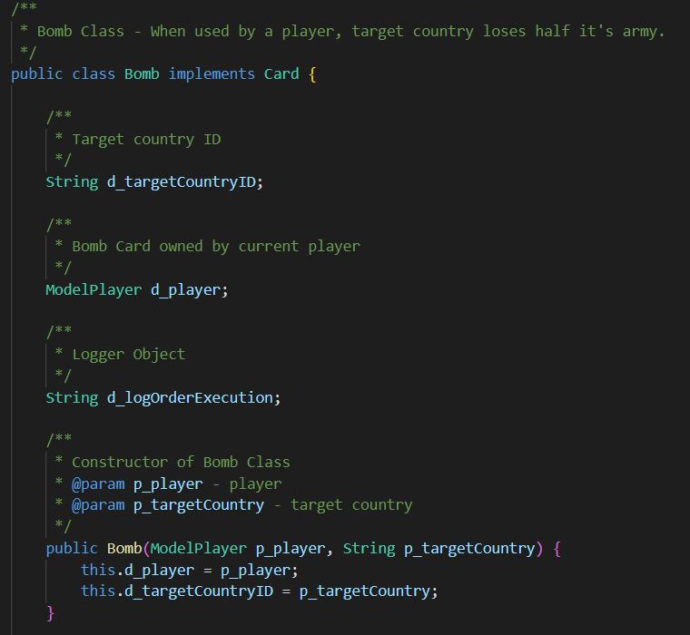
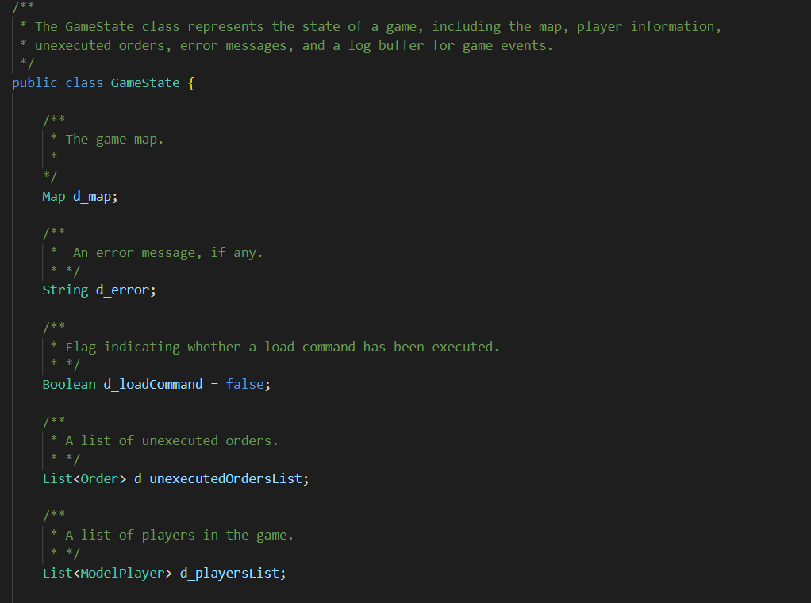
Example of Javadocs Used (Snapshots)

Slide 6
Architectural Design – State Pattern
Context: This represents the object whose behavior is state-dependent. It holds a reference to a ConcreteState object that defines the current state of the Context. Some of its methods leverage the state-specific behavior of the State object to offer context-specific functionality. A change in the state object results in a change in the behavior of the Context object.
State: This class defines the operations that each state must handle. It is typically implemented as an abstract class or interface.
ConcreteState: These classes implement the state-specific behavior.

Slide 7
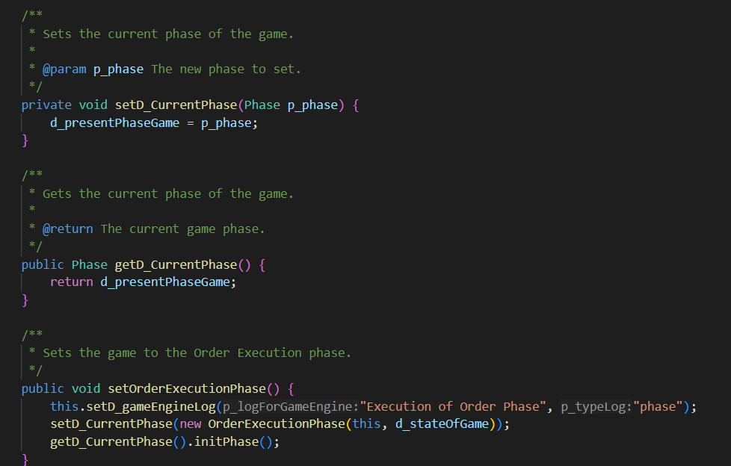
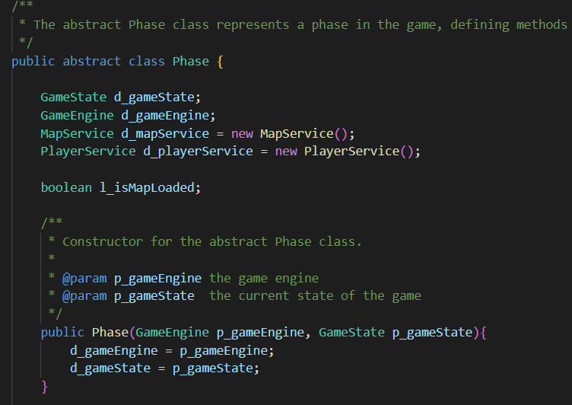
Architectural Design – State Pattern (Example)

Slide 8
Architectural Design – Observer Pattern
The elements of observer pattern are as follows:
Subject - interface or abstract class defining the operations for attaching and de-attaching observers to the client. It is often referred to as “Observable”.
ConcreteSubject - concrete Subject class. It maintains the state of the observed object and when a change in its state occurs it notifies the attached Observers. If used as part of MVC, the ConcreteSubject classes are the Model classes that have Views attached to them.

Slide 9
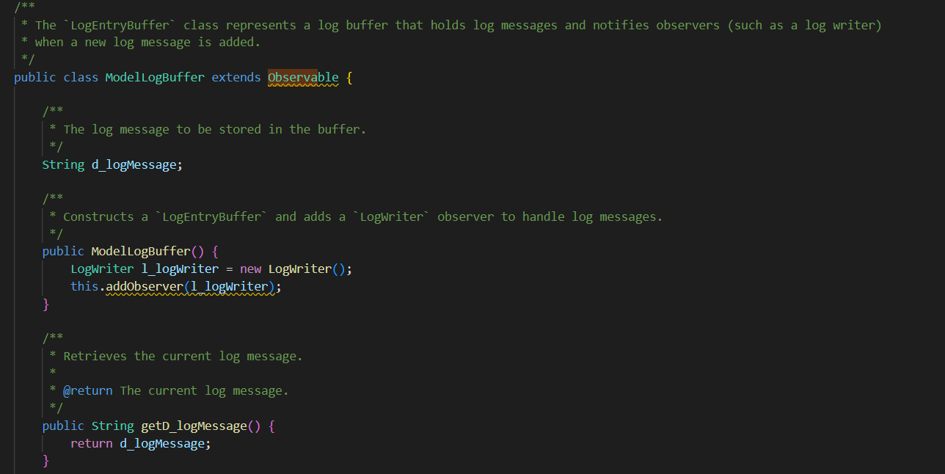
Architectural Design – Observer Pattern (Example)

Slide 10
Architectural Design – Command Pattern
The Command pattern comprises the following components:
Invoker: This is an entity responsible for generating the command object required to execute a specific operation.
Receiver: It's an entity that will be impacted or utilized when the command is executed.
Command: This class defines the operations that each command must address. It's commonly realized as an abstract class or interface.
ConcreteCommand: This object holds the context required for operation execution and contains the code that performs the actual operation.

Slide 11
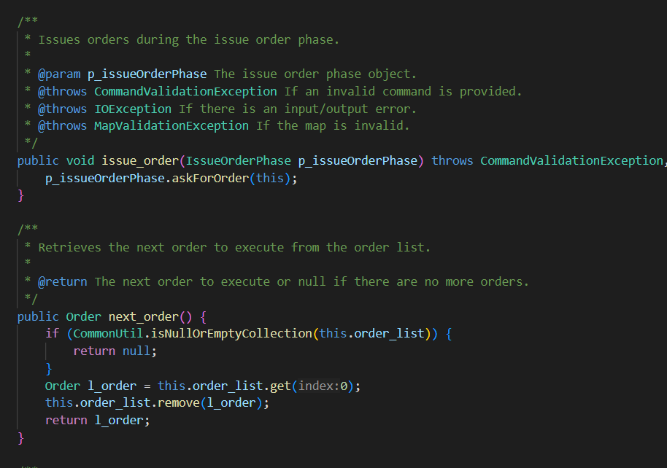
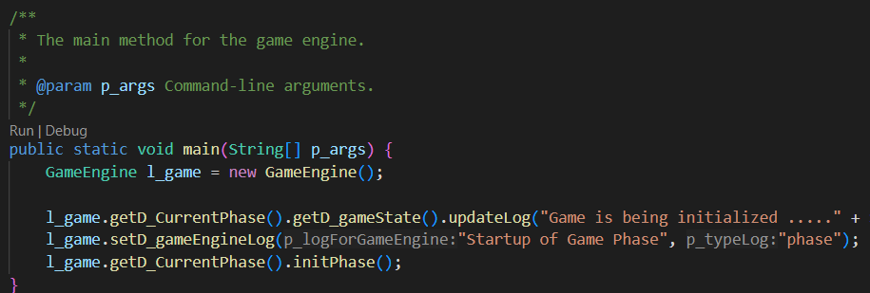
Architectural Design – Command Pattern (Example)

Slide 12
Architectural Design – Adapter Pattern
Context: Object with behavior tied to an interface, relying on an Adapter for seamless integration and leveraging interface-specific functionality.
Interface: Abstract class/interface specifying methods for adaptee classes, ensuring standardized integration.
Adapter: Acts as a bridge, enabling the Context object to interact with adaptee functionalities through a common interface.
Adaptee: Holds existing functionality for integration, necessitating an Adapter for compatibility.
Benefits: Facilitates flexible and modular code, allowing the Context object to interact seamlessly with diverse adaptee classes.

Slide 13
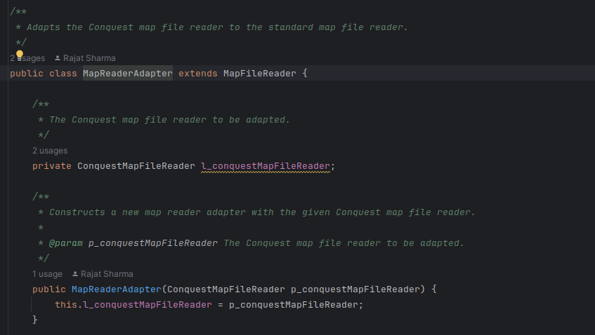
Architectural Design – Adapter Pattern (Example)

Slide 14
Player Behavior Strategies in Game Dynamics
Human Player: Requires user interaction for decision-making.
Aggressive Computer Player: Centralizes forces, attacks with the strongest country, and maximizes force aggregation.
Benevolent Computer Player: Focuses on protecting weak countries, reinforcing rather than attacking.
Random Computer Player: Deploys, attacks, and moves armies randomly within the game.
Cheater Computer Player: Conquers immediate neighboring enemies and doubles armies on territories with enemy neighbors, directly affecting the map during order creation.

Slide 15
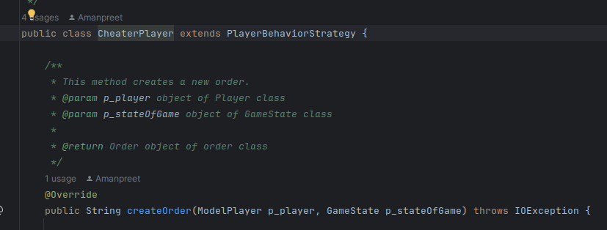
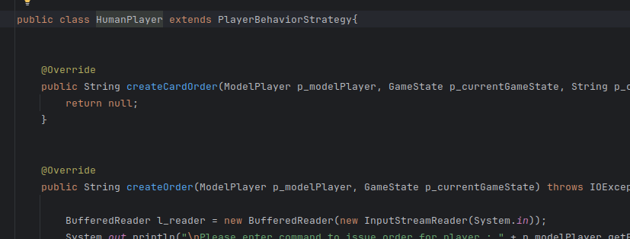
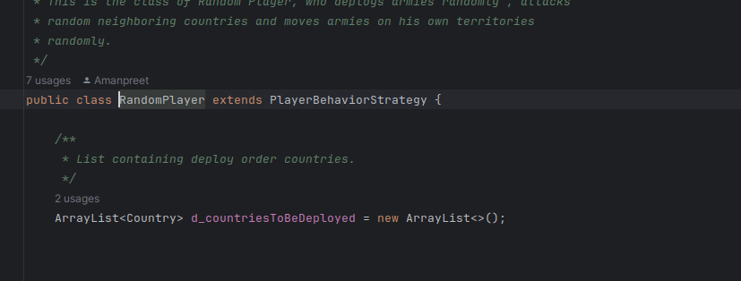
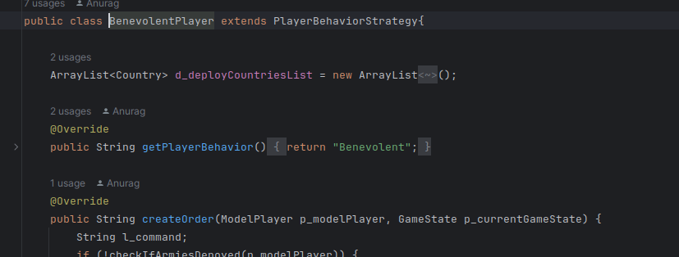
Player Behavior Strategies (code snippets)

Slide 16
Tournament Mode Overview
Tournament Configuration:
User chooses M (1-5 maps), P (2-4 player strategies), G (1-5 games per map), and D (10-50 turns per game).
Automatic Tournament Execution:
Plays G games on each of the M maps between chosen computer player strategies.
Games are automatically played without user interaction.
Draws are declared after D turns to minimize run completion time.

Slide 17
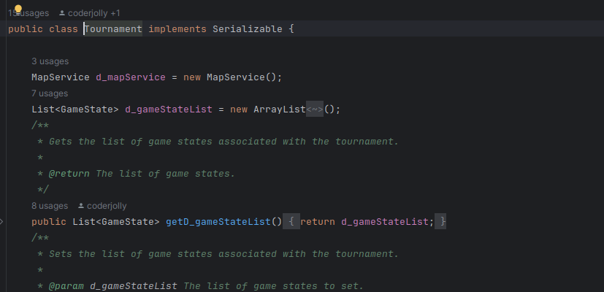
Tournament Mode Overview (code snippet)

Slide 18
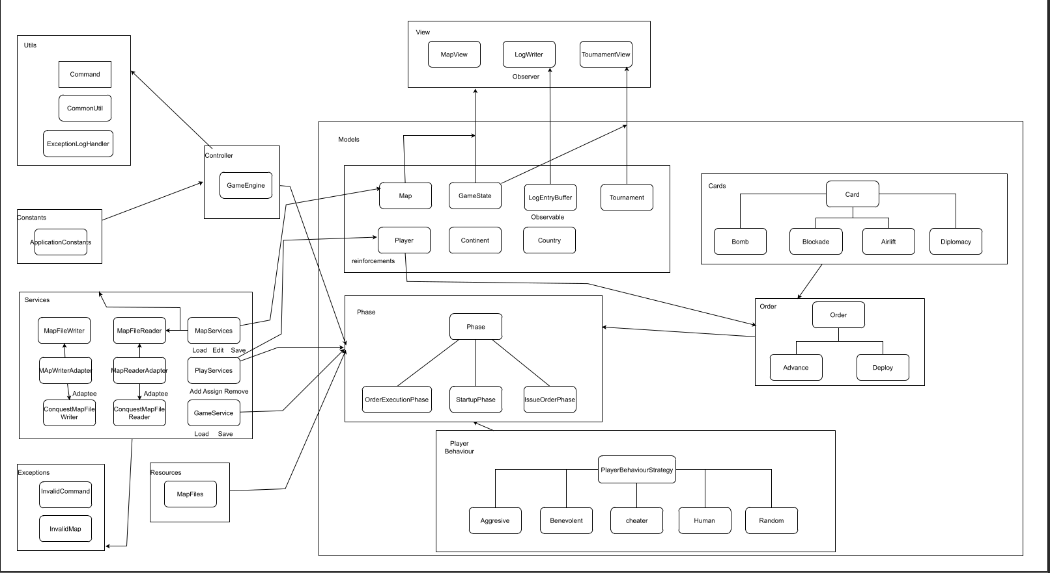
Our Design

